Slide 1

Time Series Project (MTH517A)
Analyzing and Forecasting USING Goldman Sachs Stock MARKET DATA
Supervised by: Dr. Amit Mitra
Submitted by,
Rajdeep Saha ( 201380)
Sagnik Dey (201397)
Saumyadip Bhowmick (201408)
Shuvam Gupta (201421)
Soumik Karmakar (201428)

Slide 2
Introduction
A stock market, equity market, or share market is the aggregation of buyers and sellers of stocks (also called shares), which represent ownership claims on businesses; these may include securities listed on a public stock exchange, as well as stock that is only traded privately, such as shares of private companies which are sold to investors through equity confounding platforms. The stock market is very volatile and unpredictable, and a small geographical or socio-economical change can impact the share trends of stocks in stock market, recently we have seen how COVID-19 have impacted the stock market. The randomness and forever fluctuating market make investing a risky business. In order to get ahead of the market, statisticians have always tried to analyze and forecast the stock price that reflects all known and unknown information in the public domain.
The idea of this project is to analyze Goldman Sachs Stock Market data. The objective is to analyze Goldman Sachs closing price movement and possibly fit a suitable model to build forecasts. Close Price has been chosen because it is the price at which the market settles down at a given day and it acts as a reference price for the next day.
The data used here is the daily Goldman Sachs stock market data for 3 years, Jan 2018 to Dec 2020 and is collected from the open source of Yahoo Finance.

Slide 3
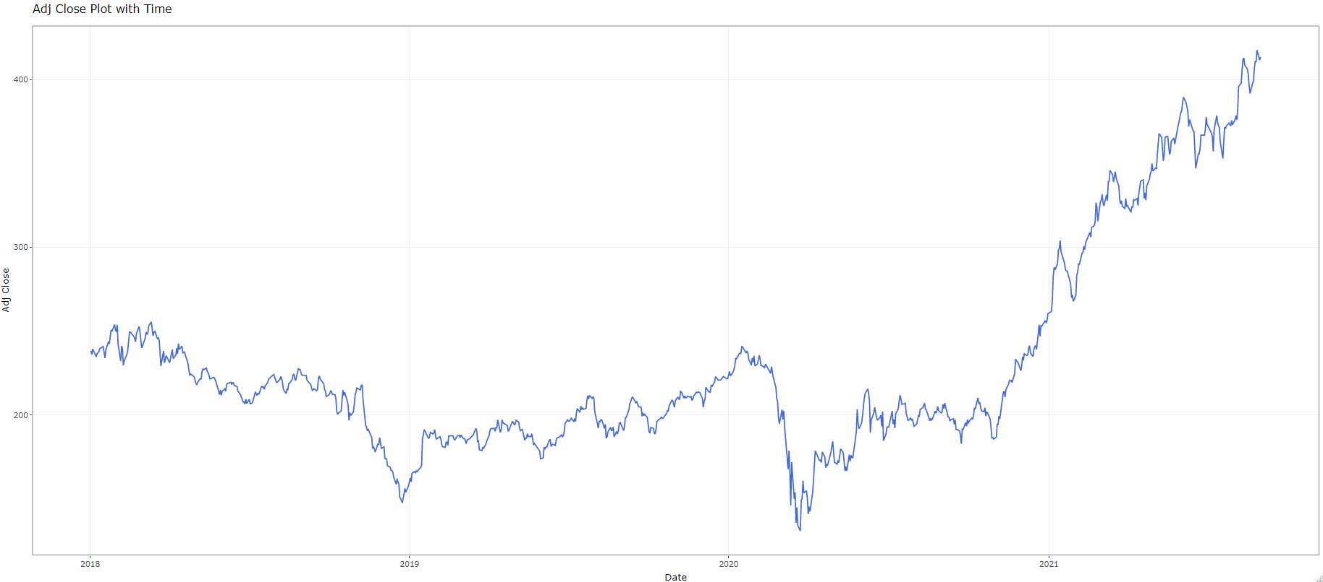
Adj Close values of Goldman Sachs stock prices
Fig: 1: Original Data

Slide 4

Test for Randomness
We shall carry out our analysis with the Univariate Data Goldman Sachs stock closing price. We shall denote our data as {X_{t}}. Firstly, we shall check whether there is any deterministic component in the data.
To investigate this, we shall go for “Turning Point Test”. It is a non-parametric test procedure to check randomness in a time series.
To test,
H₀: The series is purely random ag. H₁: not H₀
Define,
U_{i}= 1 if X_{i} is a turning point
= 0 otherwise
Suppose, P is the total number of turning points, i.e., P= $\sum_{i=2}^{n−1}{U}$_{i}
An asymptotic test for H₀ is based on the test statistic,
$Z=\frac{P−\frac{2}{3}\left(n−2\right)}{\sqrt{\frac{16n−29}{90}}}$
Z asymptotically follows N(0,1) under H₀.
Here p-value is < 2.2e-16. Hence we reject the Null hypothesis and conclude that the series is not random.

Slide 5

Test for Trend- Relative Ordering Test
Since, the null hypothesis of the Turning Point Test gets rejected, we can conclude that there is deterministic component in our data.
From the graph, we can see that, there is an increasing trend in the data. To check the presence of trend, we perform a non- parametric test procedure named Relative Ordering Test.
To test,
H₀: There is no trend in the series against H₁: not H₀
Define,
q_{ij}= 1 if X_{i}>X_{j}
= 0 otherwise
Q= $\sum_{i,j i<j}{q}$_{ij}
Q is related to Kendall’s $τ$, through the relationship,
$$τ=1−\frac{4Q}{n\left(n−1\right)}$$

Slide 6

Under the null hypothesis of no trend, we can show, E($τ$)=0, Var($τ)$= $\frac{2\left(2n+5\right)}{9n\left(n−1\right)}$
An asymptotic test for H₀ is given by,
Z=$\frac{τ−E\left(τ\right)}{\sqrt{Var\left(τ\right)}}$
Under H₀ Z asymptotically follows N(0,1).
The p-value of the test comes out to be very close to 0, hence we reject the null hypothesis and conclude that trend is present in the data.

Slide 7
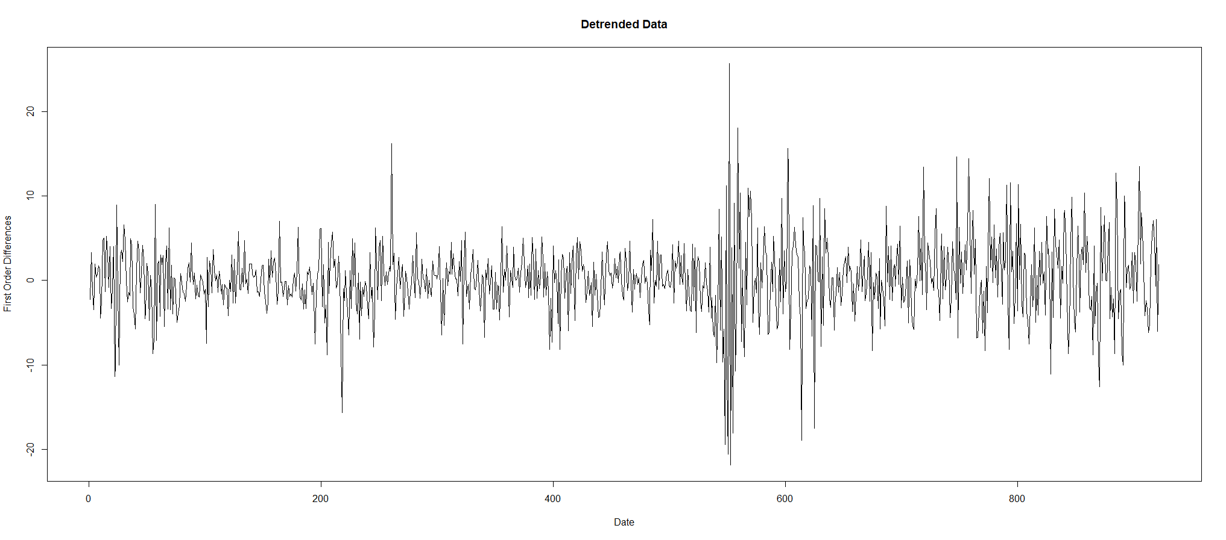

Trend Elimination- Differencing Method
In order to remove trend, we applied the method of differencing. We applied a difference operator of lag 1 on our data. In most of the cases, the stock prices are assumed to be dependent on the immediate previous value.
After applying differencing of order 1, we have obtained the series given by,
$$Z_{t}=∇X_{t}=X_{t}−X_{t−1}$$
The following figure shows the series after applying differencing.
From the graph we can conclude that, the trend has been removed after applying differencing. We again perform Relative Ordering Test on the data we have got after differencing.
We have obtained p-value > 0.01. Hence, we fail to reject the null hypothesis of no trend and conclude that the trend is removed from our data.
Fig 2: Detrended Data

Slide 8

Test for Stationarity- ADF Test
Augmented Dickey–Fuller Test (ADF) tests the Null hypothesis that a unit root is present in a time series. Here, the alternative hypothesis is that the series is stationary.
$$X_{t}=ϕ_{0}+ϕ_{1}X_{t−1}+ϵ_{t}$$
To test,
H₀: $ϕ_{1}=1$ (series is non- stationary) against, H₁: $ϕ_{1}≤1$ (series is stationary)
It is easy to see that,
$$X_{t}−X_{t−1}=ϕ_{0}+\left(ϕ_{1}−1\right)X_{t−1}+ϵ_{t}$$
or, $∇X_{t}=ϕ_{0}+ϕ^{∗}X_{t−1}+ϵ_{t}$
Here, we compare the value of test statistic with the value of Dickey Fuller distribution. If the value of test statistic is less than the value of Dickey Fuller distribution, we reject the null hypothesis and conclude that the series is stationary.
We have used p-value to draw conclusion. The value of p-value comes out to be 0.01 which is < 0.05. Hence, we reject the Null hypothesis at 5% level of significance and conclude that the series is stationary.

Slide 9
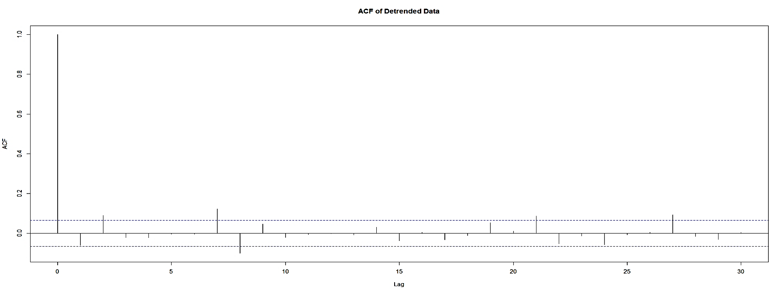
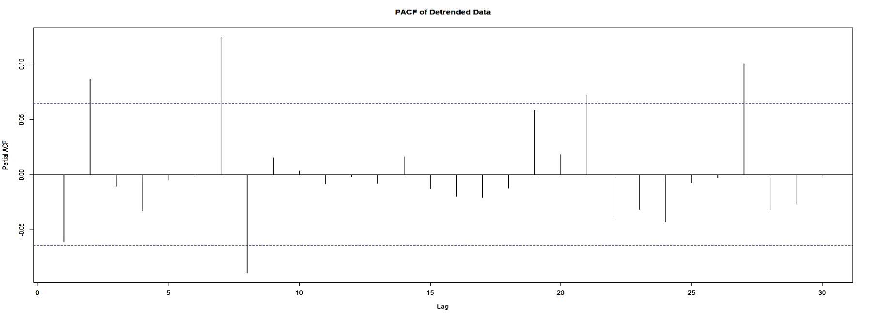
ACF and PACF plots for deciding order of AR and MA
From the graph, we can see that, in both the cases after lag 7, the values of ACF and PACF can be considered indifferent from 0. So, we consider all the 64 models with the ‘p’ and ‘q’ both less than or equal to 7. From these 64 models, we will choose that model, for which we get the minimum value of AIC (Akaike Information Criteria).
The results we have obtained shows that, the minimum value of AIC attains for ARMA(5,3) model. So, we choose the value of ‘p’ and ‘q’ as 5 and 3 respectively.
Fig 3: ACF and PACF plot of the Detrended Data

Slide 10


Model Selection for Original Data
{X_{t}} is said to follow an Auto Regressive Integrated Moving Average (ARIMA) of order (p, d, q) if,
$$Y_{t}=∇^{d}X_{t}={\left(1−B\right)}^{d}X_{t}\sim ARMA\left(p,q\right)$$
where, ‘d’ is the smallest integer for which $∇^{d}X_{t}$ is stationary. From our analysis, d= 1. So, we can use ARIMA(5,1,3) for fitting and forecasting procedure.
Residual Analysis
In our data, we have fitted, the ARIMA(5,1,3) model. The model is given by,
$\hat{x_{t}}=0.0504x_{t−1}+0.1893x_{t−2} −0.9567x_{t−3} −0.1112x_{t−4}+0.0965x_{t−5} +ε_{t}−0.1099ε_{t−1}−0.0888ε_{t−2}$ + 0.9822$ε_{t−3}$
Residuals refer to the information in training or validation set that was not explained by the model fitted. Residual analysis is performed to check whether errors follow White Noise process. The auto-correlation function having values within the confidence interval of the corresponding estimates, will indicate that the residuals are uncorrelated.

Slide 11
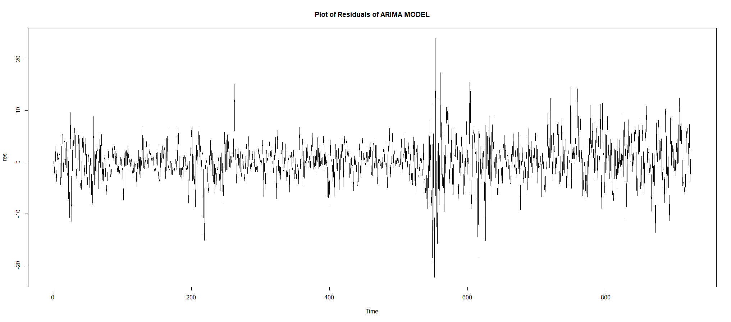

The residual plot is as shown below,
Fig 4: Residual Plot of the ARIMA Model
We perform Ljung-Box test to check whether the errors are independently distributed.
To test, H₀: The data is independently distributed ag. H₁: not H₀
The test statistic is given by:
$$Q=n\left(n+2\right)\sum_{k=1}^{h}{\frac{\hat{{ρ_{k}}^{2}}}{n−k}}$$

Slide 12
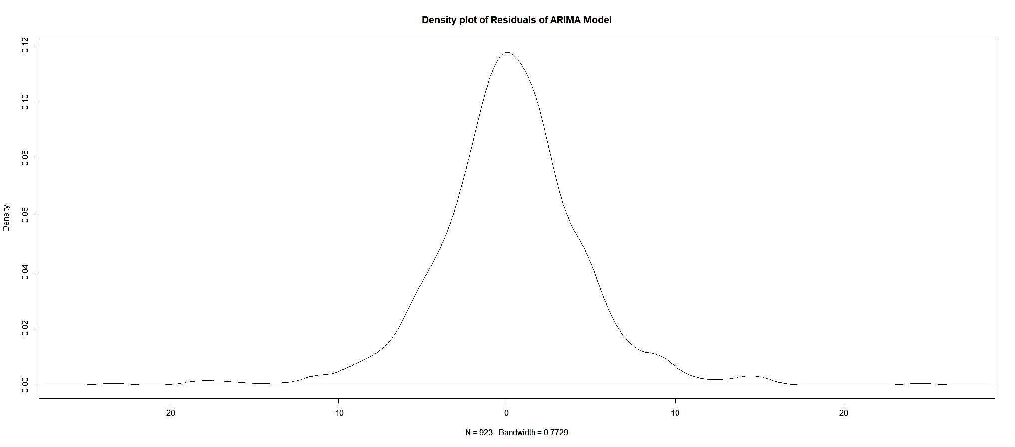

The p-value of the test came out to be 0.9714 (≥ 0.05). Thus, we accept the null hypothesis at 5% level of significance. Hence, we can conclude that the residuals are independent.
Fig 5: Density plot of Residuals
From the density plot of the residuals, we observe that the residuals are concentrated at 0 which suggests that the mean of the residuals is close to zero i.e, we have,
$$E\left(ϵ_{t}\right)=0 ∀t$$

Slide 13


Now, we wish to check whether the residuals are homoscedastic, i.e.,
$$V\left(ε_{t}\right)=constant ∀t$$
For this purpose, we wish to check whether ARCH effect is present in the model.
Lagrange Multiplier Test:
In this testing process,
H₀: ARCH-Effect is not present ag. H₁: ARCH-Effect is present
This procedure simply involves obtaining the squares of the residual from fitted model and regress them on a constant and p lagged values, where is the ARCH lags. Let us consider the equation,
$ϵ_{t}^{2}=α_{0}+\sum_{i=1}^{p}{α_{i}ϵ_{t−i}^{2}}$+v_{t}
The hypothesis is that, in the absence of ARCH components, we have $α_{i}$ = 0 for all i=1, 2,…, p, against the alternative that, in the presence of ARCH components, at least one of the estimated $α_{i}$, must be significant.
We are seeing that p-value<2.2e-16. So, we reject null hypothesis at 5% level and conclude that ARCH effect is present in the model.
First, we plot ACF and PACF of the square of the residuals.

Slide 14
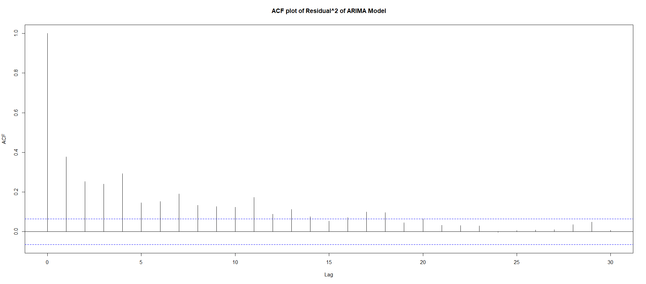
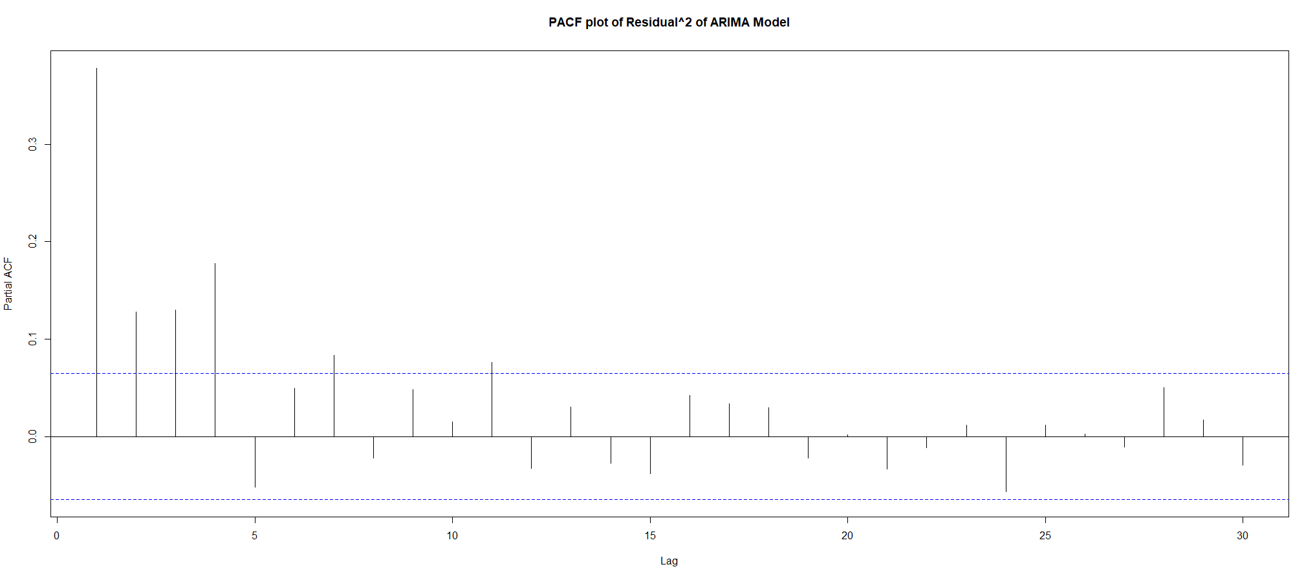
From ACF plot, we can see an exponential decay. So, we can say that, the square of the residuals follows Auto Regressive process. From the PACF plot, we can say that, after lag 7, the PACF values are not significantly different from 0. So, we can conclude, that, the square of the residuals follow AR(7) process.
Fig 6: ACF and PACF plot of the Residuals

Slide 15

Forecasting
Since, square of residuals follow AR(7) process, we can say, variance of the residuals follow ARCH(7). Using ARCH(7) process, we can estimate the variance of the residual. To obtain the estimated residual, we multiply the estimated variance of the residual with WN(0,1).
Then, the forecasted value of ARIMA-ARCH model is given by,
$$\hat{x_{t}^{′}}=\hat{x_{t}}+\hat{ϵ_{t}}$$
where, $\hat{ε_{t}}=\hat{σ_{t}}$z_{t} , z_{t} ~ N(0,1)
The series $σ_{t}^{2}$ was modeled by,$σ_{t}^{2}=α_{0}+\sum_{i=1}^{p}{α_{i}ε_{t−i}^{2}}{,α}_{0}>0,α_{i}≥0,i>0$
using ARCH(7) process on residuals of the fitted ARIMA model.
Now that an appropriate model is fitted, our next objective is to check how efficiently this model can predict future values, given the knowledge of past observations. For building up the model, we have used data from 1st January 2018 to 31st August 2021 and based on the model we got, we have forecasted value for the next 20 days, i.e., 1st September 2021 to 29th September 2021.

Slide 16
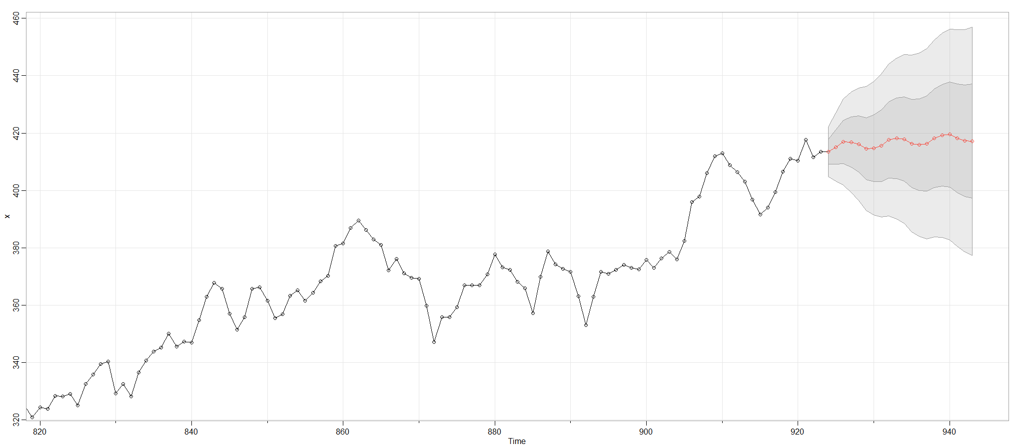
Fig 7: Overall forecast of Train and Test data

Slide 17
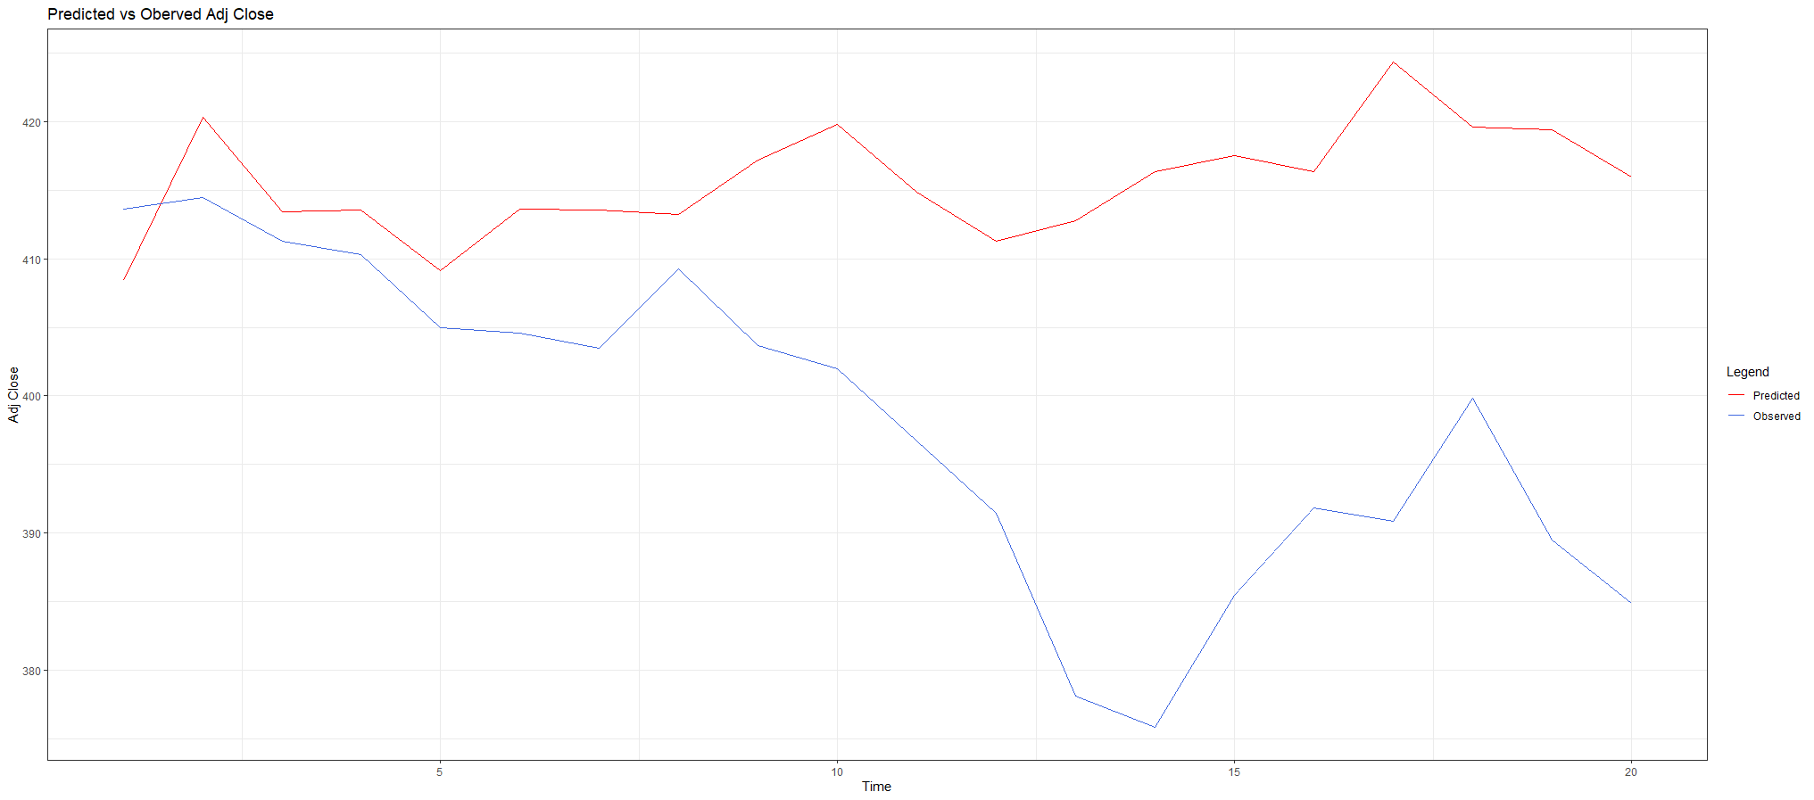
Fig 8: Predicted vs Observed Data for the next 20 days

Slide 18
Conclusion
As an evaluation metric we have used Mean Absolute Percentage Error (MAPE) . The MAPE value comes out to be 4.596, which is quite low, hence satisfactory.
Summing up all the statistical analysis, we found that ARIMA(5,1,3) fits the best on our raw data but conditional variances of the residuals are heteroscedastic. To remove this volatility , we use ARCH(7) model and conclude that the ARIMA(5,1,3)-ARCH(7) model fits our data quite accurately . Forecasting for the future 20 days with the final ARIMA(5,1,3)-ARCH(7) model resulted predicted values close to the observed ones ,validating our concern of predicting the Goldman Sachs stock market prices.

Slide 19
Thank You

